Slide 1

Processing information and presenting a solution
Module 6.3

Slide 2
Contents
Introduction
Using and processing information
Step 1: Sift the data and information
Step 2: Process the data and information
Activity 1
Finding a solution and presenting it
Planning & Completing the presentation in Word
Activity 2
Presenting the solution as a slide show
Acknowledging sources
Test and improve

Slide 3
Introduction
In problem solving you need to:
Make sure you understand the problem / break it down
Determine what data and information you need by asking many questions
Decide which information sources you are going to use
Gather as much data and information as possible

Slide 4
Introduction
When we use and process data, facts and information we get knowledge
Search
Information sources
Ask questions
Use
Process
Manipulate
Data
Information
Present
Knowledge
Understanding
Solution

Slide 5
Step 1: Sift the data and information
Using and processing information
Group information according to topics & match it to questions.
Highlight / copy any useful information. Update table as you go.
Discard information you cannot use.
If you need more information, go back and do more research.
Answers to some questions can be found in the data gathered from the questionnaires – add a note of this in your table.

Slide 6
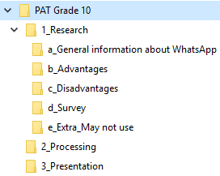
Step 2: Process the data and information
Using and processing information
Organise the data and information
You grouped the data & info belonging to each question.
Sort it further according to its importance. Identify further subtopics.
Use the same table you have been working in / write or type the topics on the information.

Slide 7
Step 2: Process the data and information
Using and processing information
Work smart – build a framework for your report
Type a framework (outline) in Word.
Main headings in report – use a Heading style.
Insert questions under headings (eventually replace these with your answers).
Summarize information – use own words.
Process questionnaires in Excel to find information.

Slide 8
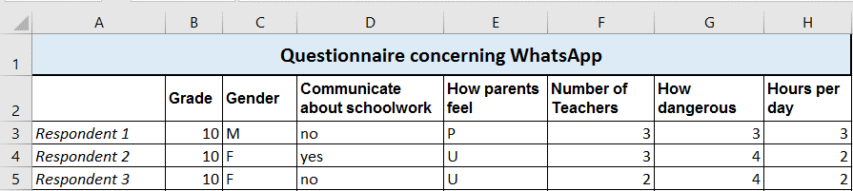
Step 2: Process the data and information
Using and processing information
Process questionnaire data – use Excel
Type in the respondents as row headings in column A.
Type questions from questionnaire as column headings, starting from column B.
Type answers from the questionnaire in corresponding cells.

Slide 9

Step 2: Process the data and information
Using and processing information
Process questionnaire data – use Excel
Calculations
COUNT – how many respondents gave specific answer.
MAX, MIN, AVERAGE – extract information from data.
Sorting
Sort, then AVERAGE – to get average value for certain group.
Sort to get minimum or maximum value for a group.
Sort, then create a chart for a group.
Charts
Easy to see patterns and trends in data.
Patterns can lead to further investigation of trends.

Slide 10
Activity 1
Complete this whole activity!

Slide 11
Finding a solution and presenting it
Planning the presentation
Decide on introduction and conclusion
Rearrange order of sections to improve flow
Insert subheadings where needed
Add more detail
Decide on key elements that answer focus questions

Slide 12

Finding a solution and presenting it
Complete the presentation in Word
Use your framework as a basis – use the same document.
Use your own words.
Arrange paragraphs logically.
Include your charts.
Don’t forget the bibliography.
Use all the Word skills and techniques you have learned

Slide 13
Activity 2

Slide 14

Finding a solution and presenting it
Present your solution as a slideshow
Must have introduction, body and conclusion
Decide what information should be under which heading
Decide how many slides
Decide on graphics and animation to support message
Use bullets to format key concepts
Add a bibliography

Slide 15
Finding a solution and presenting it
Acknowledging sources
Different schools and universities prefer different referencing systems: HARVARD / APA.
Mention in body of document where each piece of sourced information came from.
Include in Bibliography
Author
Name of publication or website
Date published
Publisher (in case of a website, the URL)
Include a bibliography at the end of the document.

Slide 16
Test and improve
Tips and recommendations
Use computer to store & process data
Refer back to problem statement / questions
Sort and group questions / info
Handle data confidentially
Look for answers to questions when processing data
Process all useful data / info
Can return and ask further questions
Recognize patterns and trends in data
Process data to avoid plagiarism; own words
PowerPoint only contains main points
Include a complete and correct bibliography

